Slide 2

IC – another way to pee
Training aimed at someone who is teaching a child to do Intermittent Catheterization (IC)
Notes:
This material is developed by
Agneta Sandberg, pediatric nurse specialist, Sweden, 2023

Slide 3
What you should know to be able to teach IC to children and parents
Knowledge of anatomy and physiology
Development of normal bladder control
Bladder dysfunction in children
What is IC
Benefits with IC
The IC method
Preparatory call
Individually adapted IC training
Knowledge of catheter assortment/materials
Where is IC performed
Frequency
Complications at IC
Follow-up
Tips and tricks
Notes:
The urinary tract is one of the most vital systems in the human body. That it functions properly is vital for a child's health. When a child is about to start with IC, it is important that children and parents gain knowledge about the anatomy and physiology of the urinary tract, as well as why the child needs to start with IC.
The user guide is a good aid for the patient to read about the therapy before and after the visit. It is important to let the child participate and learn how to catheterize independently as early as possible.
Teaching the child to urinate using a catheter is a long process, always do it on the child’s own conditions. Some impairments may result in learning difficulties, to the effect that the child will not be able to handle the catheterization process as quickly or as independently as normally expected.

Slide 4
What is Intermittent Catheterization?
IC is a method that involves regularly inserting a disposable catheter into the bladder via the urethra, either by yourself or with the help of a parent/caregiver, to empty the urine.
Children or parents/caregivers catheterize the bladder as an everyday routine.
IC is usually performed every three to four hours during waking hours.
Wash the external genital area once a day. In case of fecal leakage, always wash before catheterization.
Notes:
Not being able to completely empty the bladder in a normal way is more common than you’d think. Every year, many children are born who, for various reasons, cannot urinate or pee like others do. Older children (and adults) may also have problems urinating due to illness, injury, surgery or medication. To some people, these problems are temporary, while others will endure them for the rest of their lives.
Today, most people who experience this type of problem are helped by a therapy called Intermittent Catheterization (IC). Which means that under clean conditions, via the urethra, the bladder is emptied with a catheter, after which the catheter is pulled out again.
In the 1960s, Hinnan observed that when E.coli was instilled into a healthy bladder, no infection occurred when the patient was able to empty the bladder completely. Jack Lapides then concluded that for patients with difficulty emptying the bladder “Intermittent Catheterization should be a harmless procedure, provided the bladder is not distended. Furthermore, a clean and not aseptic technique should be sufficient as any bacteria introduced by the catheter will be neutralized by the resistance of the host”.
Intermittent Catheterization (IC) is a well-proven method that was started by Dr. Jack Lapides in the 1970s. He stated that it was more important to achieve regular emptying of the bladder than to perform sterile treatment. He introduced the concept IC and this therapy has since then been the most important emptying method when the individual's own bladder emptying ability does not work satisfactorily.
Catheters for IC are available in different sizes and models.

Slide 5
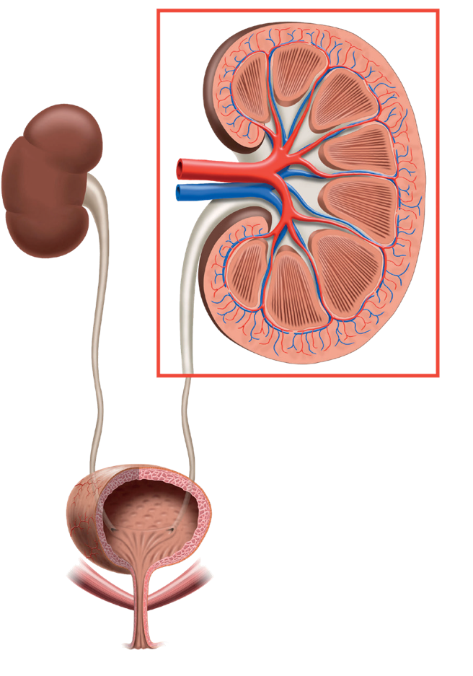
Anatomy and physiology of the urinary tract
Renal artery
Renal vein
The kidneys clean the blood and regulate the salt and water balance in the body.
The urine is transported from the kidneys via the ureters to the bladder.
The bladder stores the urine until there is a need to empty the bladder.
The urethra is surrounded by two circular muscular sphincters.
During bladder emptying, the urethra relaxes and the bladder contracts until it is empty.
Detrusor
Ureters
Kidney
Bladder
Ureter opening
Pelvic floor musculature
Sphincter
Meatus
Urethra
Notes:
The main task of the kidneys is to purify the blood. The kidneys filter the blood and form urine, which is carried down to the bladder with the help of the peristalsis of the ureters. The kidneys regulate the water and salt balance in the body. With the urine, residual products from the metabolism, urea, as well as medicines and other substances foreign to the body are removed. The kidneys also participate, among other things, in the regulation of blood pressure. The fluid balance is ensured by the kidneys regulating the amount of urine so that the urine becomes more concentrated if the body is dehydrated, and more diluted and increases in volume if one has had a lot to drink.
The bladder is a muscle-lined sac that stores and empties urine. This muscle is called the detrusor muscle. The bladder collects and stores urine until the need to urinate. The urethra is surrounded by two circular muscles called sphincters that keep urine from leaking out of the bladder. The internal sphincter works involuntarily while the external by willpower, which means that it can be controlled by squeezing.
When the bladder is full, the pressure in the urethra is higher than the pressure in the bladder. When it's time to pee, the bladder sends a message to the brain that it needs to be emptied soon. When it's time to urinate, the brain sends signals via the spinal cord to the bladder muscle, which contracts and the sphincters relax, making the urine flow out through the urethra.
In girls, the urethra is straight and only a few centimeters long. It opens just above the vagina. In boys, the urethra is longer, S-shaped, and opens at the tip of the penis.

Slide 6
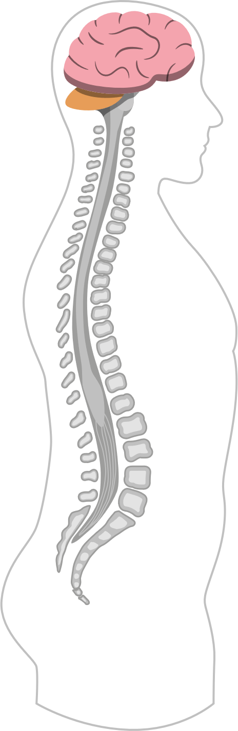
Nervous system – the communication between brain and bladder
Cerebrum
The following parts of the nervous system are involved in normal bladder function:
The brain
The brainstem
The spinal cord
Peripheral nerves
Primary Pontine
Micturition Center
Cervical Vertebrae
C1
C7
Th1
Thoracic Vertebrae
The Spinal Cord
Th12
L1
Lumber Vertebrae
L5
S1
Sacral Vertebrae
S5
Tail Vertebrae
Notes:
Adequate bladder function requires an interaction between the autonomic, non-volitionally controlled, and the somatic, volitionally controlled, nervous system. It happens through a very complicated reflex system and interaction between conscious control from the brain and unconscious control of smooth muscles in the bladder and urethra. It also presupposes that the nervous control of both afferent and efferent systems functions in the centers in the brain, brainstem, spinal cord and the peripheral nerves to the bladder and the muscles and mucous membranes of the urethra – all important to the urinary tract. In the fully developed individual, the bladder and urethra work as a unit controlled by the nervous system.
Bladder emptying is controlled from three levels in the central nervous system; the brain's frontal lobe (Central Micturition Center, CMC) with voluntary control, micturition center in the brainstem (Pontina Micturition Center, PMC) and in the lower part of the spinal cord (Sacral Micturition Center). It is in CMC that we actively make the decision to delay or allow bladder emptying. When the decision is made that it is time to urinate, the CMC sends a signal to the PMC upon which the bladder contracts and the sphincter relaxes. The Sacral Reflex Center is located in the lower part of the spinal cord. It is where the nerves that are important for bladder function; the peripheral nerves, branch off from the spinal cord. There are mainly three nerves that come from the spinal cord: The Hypogastric Nerve which is responsible for the active relaxation of the bladder muscles during filling. The Nervus Pelvicus, which ensures that the bladder contracts and the urethra relaxes during micturition. The third nerve, Nervus Pudendalis is a somatic nerve, i.e. a nerve that we can influence with our will. When the bladder becomes full, stress receptors in the bladder wall are activated and an emptying signal is registered. This is done by the CMC sending a signal to the PMC, which coordinates the sphincter and detrusor.
Command centers:
The Cerebral Micturition Centre, CMC
The Cerebral Micturition Centre is located in the frontal lobe of the brain. This is where we actively make the decision to delay or allow bladder emptying. This is done by sending a signal to the pontine micturition center.
The Pontine Micturition Centre, PMC
Located in the brainstem, the PMC co-ordinates the sphincter and bladder muscles. It acts like an on/off switch. When you want to delay bladder emptying, the PMC sends signals down the spinal cord, through the sacral reflex centre, to keep the bladder relaxed and the sphincter contracted. When you decide it is appropriate to urinate, the PMC allows the bladder to contract and the sphincter to relax.
The Sacral Reflex Centre
The sacral reflex center is located in the lower part of the spinal cord. This is where the nerves that are important for bladder function, the peripheral nerves, branch out from the spinal cord.
Peripheral nerves
The PMC is helped by three nerves that emanate from the spinal cord:
The Hypogastric Nerve
is responsible for the active relaxation of the bladder muscle during filling. When the bladder is getting full, tension receptors in the bladder wall are activated, and a strained feeling is registered in the PMC.

Slide 7

Development of normal bladder function
Babies empty their bladder little by little, approx once per hour.
A newborn baby’s bladder can hold about 30 ml.
Gradually, as the child gets older, the child urinates less often. Older children pee about every 3-4 hours.
The bladder grows about 30 ml per year.
By the age of 3, more than 80 % are continent during daytime.
By the age of 6, more than 90% are continent both day and night.
Notes:
The fact that fetuses and infants empty their bladders several times a day indicates that the coordination of the musculature of the bladder and the muscles around the urethra is not yet fully developed.
At this age, the bladder empties by reflex when a certain volume is reached. Most of the time, the bladder empties completely, but not always. In those cases, the bladder is soon emptied again to avoid residual urine. It is still important to emphasize that a healthy child should urinate in portions. There should be no leakage. This is typically a child who is physiologically continent, but not socially continent.
By the age of 2-3, children can begin to control their bladder by willpower and by 3, more than 80% are continent during the day. 90% of all six-year-olds are dry both day and night. They can now control both the sphincter and the bladder and can initiate as well as terminate urination.
By the time a child has reached adolescence, the bladder has reached adult capacity, which is about 500 ml.

Slide 8

Pathophysiology – There are three main types of bladder dysfunction
Storage problems: Inability to keep urine in the bladder, for example various forms of incontinence.
Emptying problems: Inability to empty the bladder completely.
A mixture of different types of incontinence and retention.
Notes:
The bladder has two functions, to store and empty urine, of which the latter is critical. If the bladder cannot be emptied, kidney function is seriously threatened. Leakage of urine, urinary incontinence, is socially and psychologically very troublesome for the child and the family, but no danger to the kidneys. It is not unusual to have disturbances in both storage and emptying of urine. It is of the utmost importance that children with storage and emptying symptoms are examined and receive treatment.

Slide 9
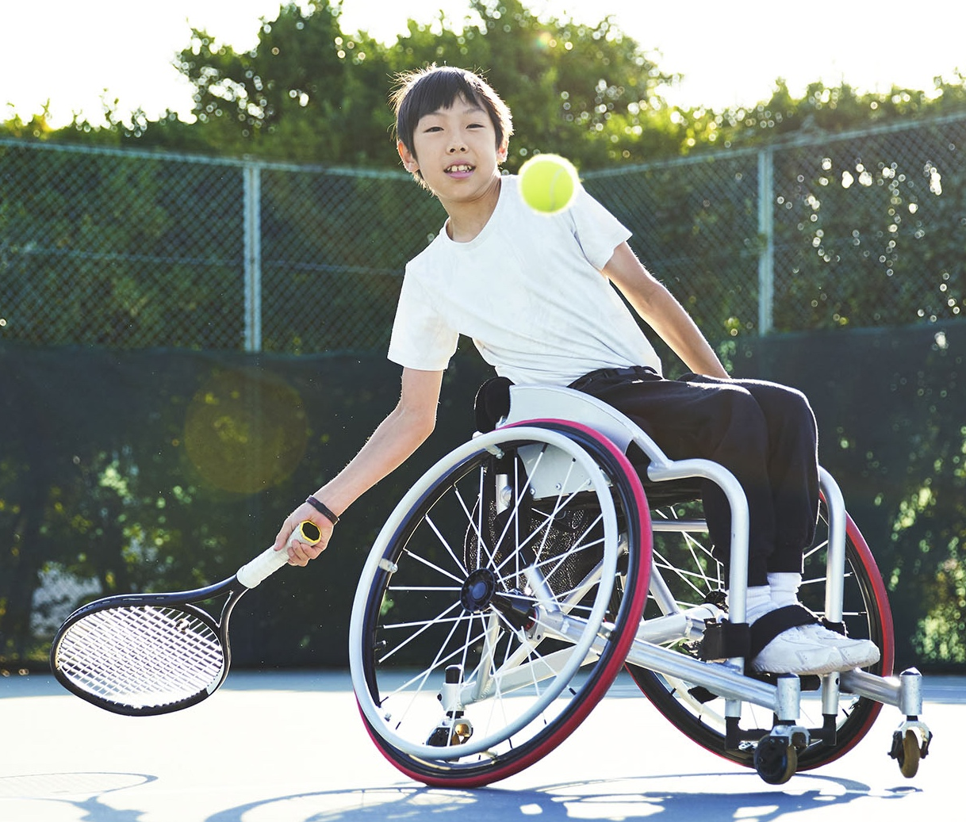
Difficulties in bladder emptying
Neurogenic damage
  The most common conditions that cause neurogenic bladders in children are congenital defects, e.g. Spina Bifida.
Outflow obstruction
  Meatus stenosis
  Urethral valve
  Epispadias
Congenital malformations
such as bladder exstrophy
Notes:
Neurogenic damage:
Neurogenic bladder disorder is caused by a disturbed innervation, nerve supply, to the bladder and/or sphincter. This damage can cause the bladder to be hypoactive (meaning it cannot contract and empty completely) or hyperactive (where it contracts too quickly or often). Nerve damage can result in deterioration of the bladder muscle and/or sphincter.
A neurogenic bladder disorder can lead to three main problems: high pressure in the bladder, difficulty emptying and urine leakage.
In case of high pressure in the bladder, the urine can be forced back to the kidneys again, together with bacteria that can lead to infections in the kidneys as a result.
When the interaction between the sphincter and the musculature of the bladder does not work, both contract simultaneously when the bladder is to be emptied. This is called detrusor-sphincter dyssynergy and leads to the inability of the bladder to empty. In this so-called residual urine, bacteria can grow and lead to urinary tract infections. The most common causes of kidney damage in people with neurogenic bladder disorder are high pressure in the bladder and urinary tract infections.
Effluent obstructions: An obstruction during emptying; something that is in the way of urine flow. Obstruction of outflow is characterized by high pressure in the bladder and a weak flow during urination.
Congenital malformations: Bladder exstrophy is an unusual malformation where the bladder is not closed but lies open on the lower part of the abdomen when the baby is born.

Slide 10

Important factors when teaching IC
After doctor’s prescription
It may sound difficult at first, but once you learn it’s easy. To get there, the child needs to build routines, strategies and self confidence.
It doesn't take longer to pee with a catheter than to pee the normal way.
From about 5 years of age, you’re able to handle a catheter yourself.
IC should not affect social life.
Find IC times that are convenient.
Not in the middle of a game.
Use various teaching materials
(film, brochures, pictures).
Adjust the length and CH of the catheter based on the child's age
and function.
Notes:
Thousands of children, women and men around the world self-catheterize themselves 4-6 times a day, every day.
It may sound bothersome and difficult at first, but after most people learn RIK, they find it easy. For a child to learn IC, training is required. This is done by building routines and strategies that are based on one's own abilities and self-confidence.
In addition to the actual insertion of the catheter into the bladder, the child/youth must be able to keep track of IC times, movement, hand washing, bringing out/putting away materials and undressing and dressing.
After training IC and getting used to it, IC will become a daily routine and it will not be an obstacle for either child or parent from living a normal life.
Find situations and times of the day that are suitable for carrying out IC. This means that IC does not interfere with school, play or other activities too much.
Children with spinal cord injuries may have impaired motor function and sensation, it is therefore important that the environment and equipment for IC is adapted to the child's conditions.

Slide 11
How often and when is IC performed?
Regular bladder emptying every
three hours during daytime.
Sometimes catheterization is performed at night or the child uses an indwelling catheter at night.
Adapt catheterization times to the child's life and routines.
Plan catheterization times to fit
into the child's schedule at school.
Let the catheterization times be related to other events.
Come up with tricks that make it easier for the child to remember when it is time to catheterize.
Notes:
Studies have shown a clear correlation between long intervals between catheterizations and the presence of bacteria in the urine. Increased risk with IC intervals > 4 hours and bladder volumes > 400 ml. It is important that the child's emptying times are adapted to the child's life and routines.
If the emptying times are connected to other events, e.g. breakfast, breaks, the end of the school day and bedtime, it may be easier to remember to empty.
Try to come up with tricks that make it easier for the child to remember when it is time to catheterize. A clock that sounds or vibrates or a mobile phone signal can help support the child’s memory.
It is better to perform IC once too often than once too rarely. For school children, IC must not be performed during breaks. It is important from a social perspective that the child gets to spend time with friends during breaks. It is equally important to start the break at the same time as the classmates in order to be involved from the beginning. Nor is it suitable to schedule IC times at the beginning of a lesson when introductions are made. It is better for the child to go to the toilet at the end of the lesson, well before the break. The teacher needs to be informed about the IC time in order to be able to adapt the planning of the lesson.

Slide 12
Where is IC performed?
IC of babies takes place on changing tables.
When the child’s balance improves, the catheterization is performed with the child sitting on the adapted toilet seat.
For most effective bladder emptying, it is important to have a safe and relaxed sitting position on the toilet.
Use an individually adapted toilet seat following advice from the child’s urotherapist / nurse and occupational therapist.
Let the child understand that bladder emptying is something you do in the privacy of the toilet.
The child's sitting position needs to be evaluated as the child grows.
At the start of school, the child needs a locker in the toilet to store catheters and other materials.
Notes:
The place where IC is performed varies depending on the child's age. On babies, IC is usually performed in connection with diaper changes, which is why the changing table becomes a natural place. As the child gets older and can sit more steadily, it is preferable that the child stays in a sitting position and that IC takes place on the toilet. Possibly, the toilet seat needs to be adapted so that the child feels safe and relaxed. Here it is important to collaborate, e.g. together with occupational therapist. It is important that the sitting position is evaluated regularly, not only from a safety and IC technical point of view, but also to evaluate the effectiveness of the emptying, i.e. to measure residual urine after emptying. Evaluation of the sitting position applies not only to the home environment but also in places where the child spends a lot of time (preschool and school).

Slide 13

Preparatory talks
It is vital to create a trusting and confident relationship with children and family
Start with informing and inspiring parents about the anatomy and physiology of the urinary tract
The reason why their children need IC
After that, children and parents are informed together on a level adapted to their child.
Build trust with the child – become a team
Don't promise more than you can keep
Don't do more than you promised
Be patient, very patient!
Always start with the positive/encourage
Notes:
Children notice immediately when parents feel anxious and worried. It can therefore be of value to first give parents all the information and time they need to feel confident about their child starting IC, in order to then be able to support their child. After that, children and parents can get information together on a level adapted to their child. It is important that children and parents understand why they need to start with IC - create trust.

Slide 14
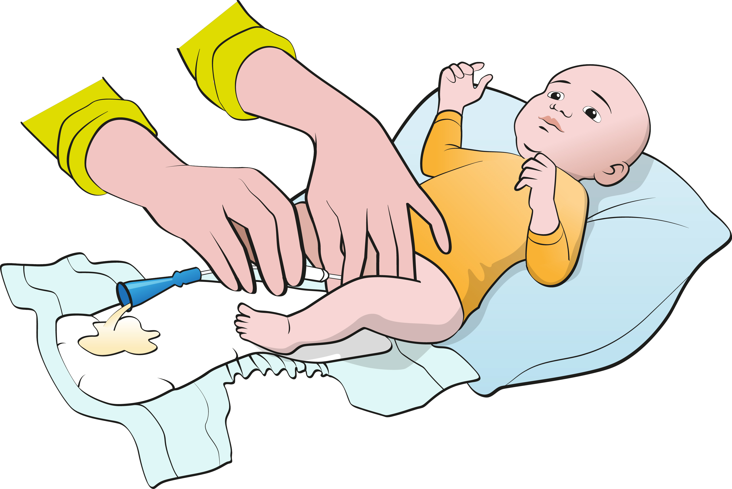
Self-training 0-2 years
It’s an advantage to start IC therapy in infancy before the child becomes too active. The child's experiences of IC will then be less traumatic.
The therapy can always be terminated if it is not needed.
IC of babies takes place on the changing table, but when the child’s balance improves, the catheterization is performed on the adapted toilet seat on the toilet.
Self-training starts when the child shows interest, from about 1 year of age.
Let the child examine and play with a catheter.
Encourage the child to participate. Let the child pick up the catheter, open the package.
Notes:
Although the child at this age is usually not continent, it is important that the child empties the bladder completely to avoid infections and kidney damage.
Placing a pillow under your child's back will give the body an angle that will make it easier to make sure the bladder is completely empty. You can also apply light pressure with your hand over the pubic bone when the urine has stopped flowing before pulling out the catheter. It is good if the child stays in a sitting position when performing IC as soon as the child sits firmly on the potty or toilet seat.
Allow the child to participate, at around 1 year of age or when the child shows an interest in some part of the therapy, e.g. to take out the catheter and open the catheter packaging.

Slide 15
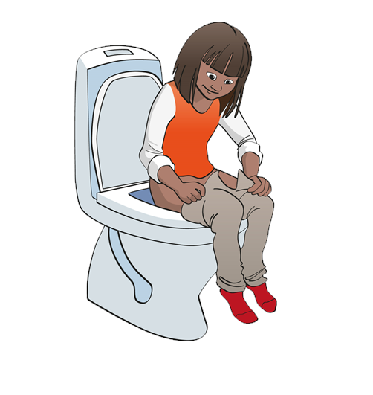
Self-training 2-4 years
IC starting in preschool age requires careful preparation and a lot of patience to avoid creating a traumatizing experience.
Support the parent because children at this age may have a strong will, and it may require great patience on the part of the parent to catheterize the child.
It is important that the child learns that bladder emptying is something private
and that it is carried out in the toilet.
Take advantage of the child's natural curiosity.
Let the child help to help, e.g. they can help to gently pull out the catheter after bladder emptying.
Get a doll with "pee holes" that the child can practice catheterization on.
Notes:
Teaching the child to urinate using a catheter is a process. Always adapt training to the child’s conditions. Children at this age are often motorically active and have a strong will of their own, which can make it difficult to start IC at this age. For children who have already started IC, this is rarely a problem. It is valuable to let the child participate and learn how to catheterize as early as possible. The training to self-catheterize is adapted individually and with appropriate milestones, all based on the child's cognitive ability and hand function.

Slide 16
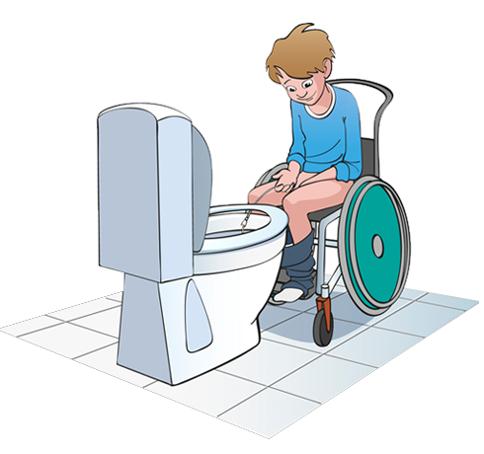
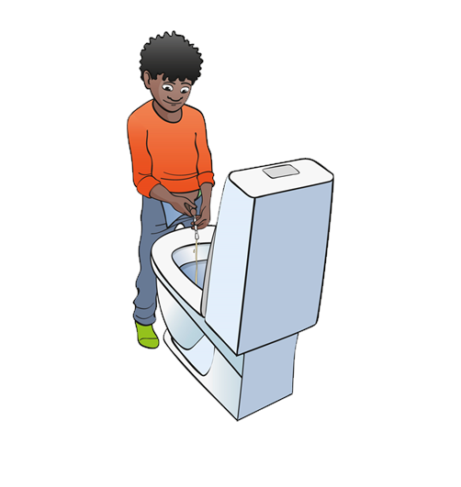
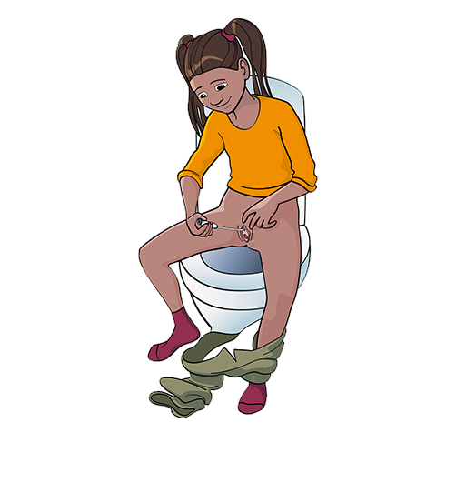
Self-training 2-4 years
IC starting in preschool age requires careful preparation and a lot of patience to avoid creating a traumatizing experience.
Support the parent because children at this age may have a strong will, and it may require great patience on the part of the parent to catheterize the child.
It is important that the child learns that bladder emptying is something private
and that it is carried out in the toilet.
Take advantage of the child's natural curiosity.
Let the child help to help, e.g. they can help to gently pull out the catheter after bladder emptying.
Get a doll with "pee holes" that the child can practice catheterization on.
Notes:
Teaching the child to urinate using a catheter is a process. Always adapt training to the child’s conditions. Children at this age are often motorically active and have a strong will of their own, which can make it difficult to start IC at this age. For children who have already started IC, this is rarely a problem. It is valuable to let the child participate and learn how to catheterize as early as possible. The training to self-catheterize is adapted individually and with appropriate milestones, all based on the child's cognitive ability and hand function.

Slide 17
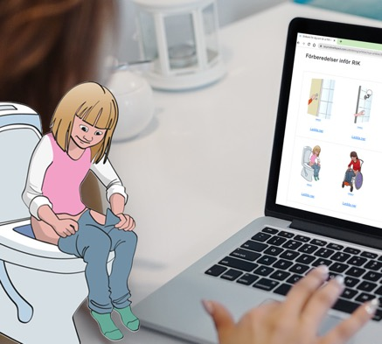
Self-training for children older than 4 years (cont'd)
Let children tell stories with their own pictures.
Clear and simple images make it easier for children with perception disorders
The urotherapist's role is to teach IC to parents and children.
It is the parents' task to teach IC in preschool and school.
The goal is for the child to be able to perform IC independently before the start of school.
Anna
Notes:
It is of great importance that the urotherapist/nurse creates a trusting and confident relation to the child and family.
Let the child tell the story of how the bladder and kidneys work using his own imagery (drawing or painting)
The urotherapist's role is to teach IC techniques to parents and children.
In kindergartens, preschools and schools, it is usually the parents' task to teach IC and, if necessary, a urotherapist/nurse may participate. The most important thing at this age is to motivate the child to cope with as much of the catheterization process as possible. This means undressing and dressing, remembering the time, going to the toilet, preparing the catheter, washing hands, inserting the catheter, making sure the bladder is empty, removing and disposing of the catheter, getting dressed, washing hands.

Slide 18
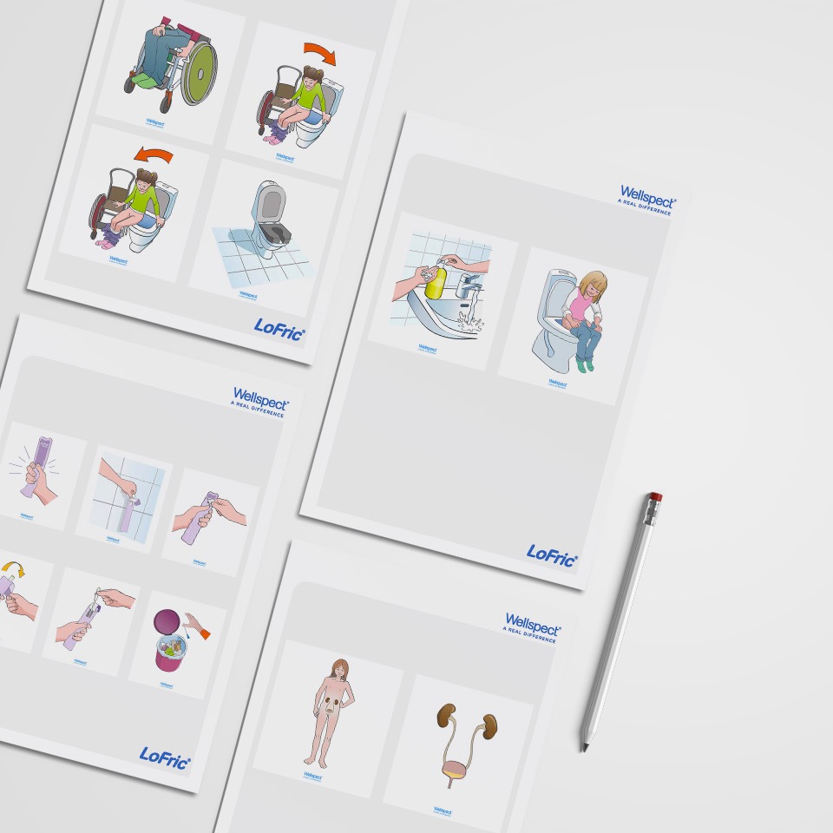

Information material to children and parents which will facilitate getting started with the IC procedure
Notes:
Just as is shown in published studies it’s of main importance to provide good education and information to the patient before initiating IC, as well as thorough follow-up.
Wellspect offers o wide assortment of information to allow a good start for the patient.

Slide 19
Strategies for success with IC (10 small steps to IC)
Point with your finger, and then
touch the urethral opening.
Hold your finger against the urethral orifice and slowly count to 10.
Point the catheter at the urethral orifice.
Stir the urethral orifice with the catheter.
Touch the urethral orifice with the catheter and slowly count to 10.
Make the top of the catheter disappear into the urethral orifice.
Insert the catheter a little more, about 3 cm into the urethra.
Insert the catheter a little more, into the urethra.
Insert the catheter so there is pee.
Slowly pull out the catheter when is no longer any pee.
Notes:
Starting IC on a child of preschool age requires patience and very careful preparation to avoid a traumatic experience for the child.
Build trust with the child - form a team.
Take small steps and agree with the child when it is time to take the next step.
Don't do more than you promised.
Don't promise more than you can keep.
For small children who start IC at an early age, problems rarely arise later when the child has to learn by himself. It has become a routine for both child and parent. The child has already become involved in self-training by IC.
It becomes natural for the child to see and learn step by step from his parents.

Slide 20
IC method-girl
Notes:
Pick out the material needed for IC (catheter and possibly new leakage protection).
Wash your hands.
Prepare the catheter.
Sit in a tested optimal sitting position or stand up.
With one hand: separate the labia.
With the other hand: insert the catheter until the urine begins to flow.
Hold the catheter until the urine stops flowing.
When the urine has stopped flowing, insert the catheter a little further.
If urine starts to flow again, wait until it stops flowing, then slowly pull out the catheter.
If the bladder is difficult to empty, put pressure over the abdomen or cough with the catheter left in the bladder.
Make sure to wash your hands before IC and after using the toilet. Hand sanitizer are ideal when in public toilets. Wash the abdomen once a day, but also in case of fecal leakage and large urine leakage. Do not allow the catheter surface to come into contact with anything before it is inserted into the urethra. When a girl is sure of her anatomy, she moves over to the toilet seat and uses a mirror to see where the urethra is. It is important that the girl gets to know where the urethral opening is and not to have a mirror during the IC procedure.

Slide 21
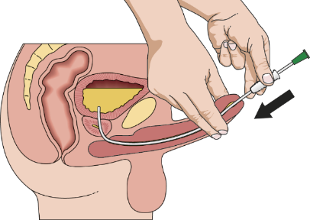
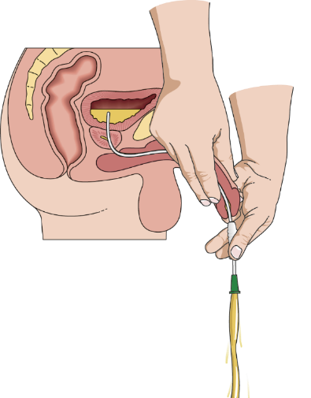
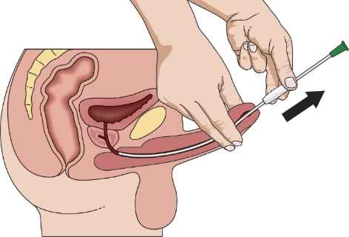
IC method-boy
Notes:
Pick out the material needed for IC (catheter and possibly new leakage protection).
Wash your hands.
Prepare the catheter.
Sit in a tested optimal sitting position or stand up.
With one hand: hold the penis outwards/upwards towards the abdomen.
With the other hand: insert the catheter until the urine begins to flow.
Hold the catheter until the urine stops flowing.
When the urine has stopped flowing, insert the catheter a little further.
If urine starts to flow again, wait until it stops flowing, then slowly pull out the catheter.
If the bladder is difficult to empty, put pressure over the abdomen or cough with the catheter left in the bladder.
Make sure to wash your hands before IC and after using the toilet. Hand sanitizer are ideal when in public toilets. Wash the abdomen once a day, but also in case of faecal leakage and large urine leakage. Do not allow the catheter surface to come into contact with anything before it is inserted into the urethra.

Slide 22
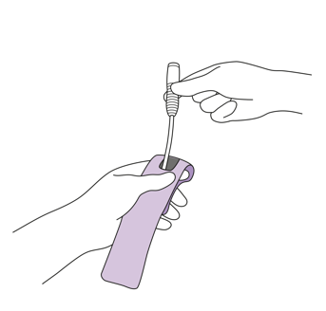
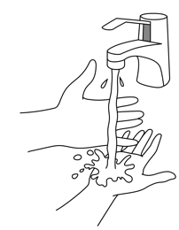
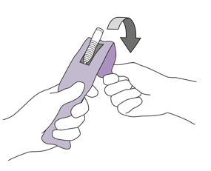
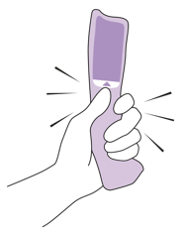
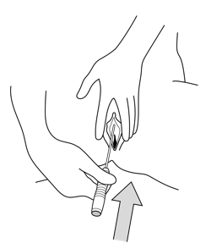
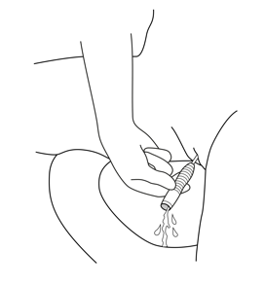
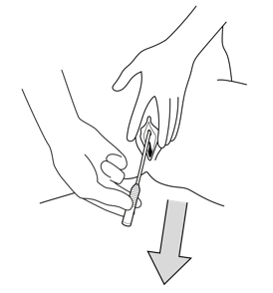
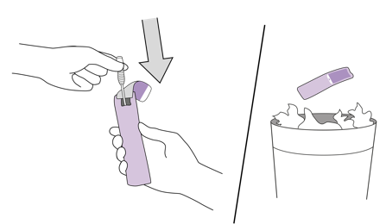
IC method- girl
1.
2.
3a.
3b.
4.
5.
6.
7.
Notes:
Make sure to wash your hands before IC and after. Hand sanitizer are ideal when in public toilets. Wash the abdomen once a day, but also in case of faecal leakage and large urine leakage. Do not allow the catheter surface to come into contact with anything before it is inserted into the urethra. When a girl is sure of her anatomy, she moves over to the toilet seat and uses a mirror to see where the urethra is. It is important that the girl gets to know where the urethral opening is and not to have a mirror during the IC procedure.
Pick out the material needed for IC (catheter and possibly new leakage protection).
Wash your hands.
Prepare the catheter.
Sit in a tested optimal sitting position or stand up.
With one hand: separate the labia.
With the other hand: insert the catheter until the urine begins to flow.
Hold the catheter until the urine stops flowing.
When the urine has stopped flowing, insert the catheter a little further.
If urine starts to flow again, wait until it stops flowing, then slowly pull out the catheter.
If the bladder is difficult to empty, put pressure over the abdomen or cough with the catheter left in the bladder.

Slide 23
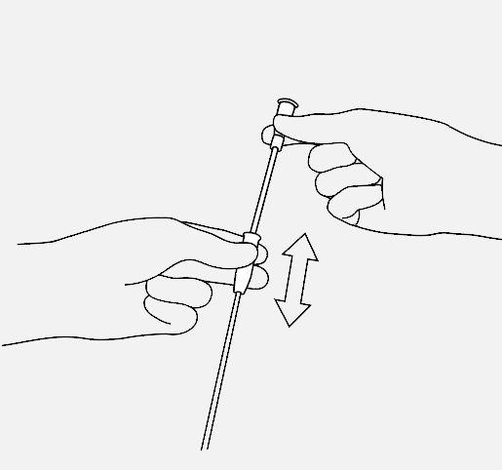
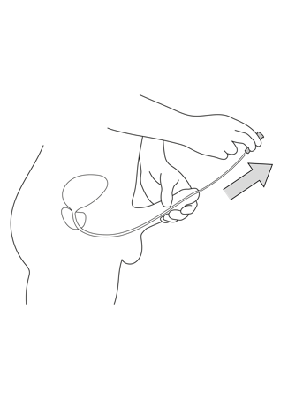
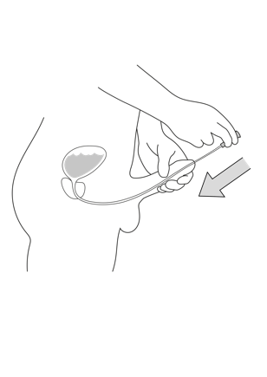
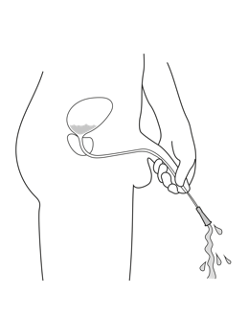
IC method- boy
1.
2.
3.
4.
5.
6.
7.
8.
9.
Notes:
Pick out the material needed for IC (catheter and possibly new leakage protection).
Wash your hands.
Prepare the catheter.
Sit in a tested optimal sitting position or stand up.
With one hand: hold the penis outwards/upwards towards the abdomen.
With the other hand: insert the catheter until the urine begins to flow.
Hold the catheter until the urine stops flowing.
When the urine has stopped flowing, insert the catheter a little further.
If urine starts to flow again, wait until it stops flowing, then slowly pull out the catheter.
If the bladder is difficult to empty, put pressure over the abdomen or cough with the catheter left in the bladder.
Make sure to wash your hands before IC and after using the toilet. Hand sanitizer are ideal when in public toilets. Wash the abdomen once a day, but also in case of faecal leakage and large urine leakage. Do not allow the catheter surface to come into contact with anything before it is inserted into the urethra.

Slide 24

Advantages with Intermittent Catheterization
Regular emptying of bladder
under low pressure
Improved and/or maintained bladder-
and kidney capacity
Reduced risk of UTIs.
Reduced urge to urinate
Reduced leakage
Improved quality of life
Lapides, Diokno, Silber and Lowe,1972 EAUN summary quidelines 2013
Notes:
IC is considered gold standard for bladder emptying when bladder management is needed. IC is associated to a much lower level of complications compared to indwelling and suprapubic catheterization. IC mimic the natural way of emptying the bladder.

Slide 25
IC complications
  Urinary tract infection:
    Caused primarily by too few IC sessions or incomplete emptying (wrong technique)
    Insufficient flow
    The catheter is pulled out too quickly or has not been in the bladder
  Streaks of blood on the catheter
  Bladder stone
  Epididymitis
  Urethra stricture and false passages in the urethra
Notes:
Incomplete emptying may be due to constipation. A full bowel presses on the bladder and makes it difficult to empty urine using the catheter.
A catheter that is too thin results in poorer flow, and the often-occurring white sediment in the bladder, which consists of salts, dead cells, bacteria, etc. has difficulty emptying.
Optimize the child's sitting position or emptying position.
A thin catheter is more pointed, which can increase the risk of false passage in boys.
A catheter that is pulled out too quickly, before the bladder is empty, can be the cause of incomplete emptying.
Streaks of blood on the catheter are common during the first month of IC treatment and do not require any action.
Bladder stones are usually due to poor emptying technique and/or the presence of stone-forming bacteria.
Epididymitis (inflammation of the epididymis) is uncommon in young boys but can occur in connection with IC.
Studies show that if a person can insert the catheter himself/herself, fewer infections and damage to the urethra occur.

Slide 26
Tips and tricks
  Inject anesthetic gel into the proximal area of the urethra to locate the urethral orifica in girls.
  With girls, use a mirror to show where the opening of the urethra is located.
  The foreskin does not need to be pulled back completely before the catheter is inserted into the urethra, but the urethral orifice must be visible.
  When the catheter forms an ”S”, it is advisable to wait for a few minutes, leaving the catheter in place in the urethra, then continue.
  Meet with other children and adolescents that practice IC.
  Use a reward, such as a diploma or a sticker.
  Bring your catheters in your hand luggage when traveling by air. Checked luggage may get lost.
  Keep catheters in different places where the child often spends time.
Notes:
The urethral opening in girls can sometimes be difficult to find due to its varying location. It is therefore important that the girl knows her anatomy and knows where the urethra is before starting to train with the catheter. It can be helpful for the girl to lie on a bunk and use a mirror to show where the urethra is. When the girl is sure of her anatomy, she moves over to the toilet seat, where she also uses a mirror to locate the urethra. Then she starts trying to insert the catheter without the use of a mirror.
If it is difficult to locate the urethral opening, anesthetic gel can be injected into the nearby area to fill the lower part of the urethra, which is then seen as an enlarged dark opening.
In small boys, the foreskin does not need to be pulled back completely before the catheter is inserted into the urethra, but the urethral orifice must be visible, so that the catheter does not find its way around under the foreskin.
In case of sphincter resistance, the catheter forms an "S". It is then advisable to wait a few minutes with the catheter in place in the urethra. The child can take a deep breath and then a new catheterization attempt is made just as the child exhales. It is good for children and young people who use IC to get to share the experience with others who also use IC. It is also positive with different reward systems that encourage training.
Store catheters in different places where the child usually spends time: at grandma's, in the car, at mother's workplace, etc.

Slide 27
The benefits of Intermittent Catheterization
Regular emptying of the bladder under low pressure.
Improves or preserves bladder and kidney function.
Reduced risk of urinary tract infections.
Decreased urge to urinate.
Decreased urine leakage.
Better quality of life.
Lapides, Diokno, Silber and Lowe,1972
EAUN summary quidelines 2013
Notes:
Intermittent Catheterization (IC) is a safe and effective method that involves regularly emptying the bladder with a disposable catheter by the individual or by another person (caregiver).
Available clinical evidence support the strategy of always considering IC as the first choice, before considering the use of an indwelling catheter.
Intermittent Catheterization is similar to normal bladder emptying and has very few contraindications. The bladder is regularly emptied under low pressure.
Preserved health of the upper urinary tract, preserved kidney function and reduced risk of UTI are the main reasons for recommending IC.
The biggest benefits for the child starting with IC are being able to be continent and independent.

Slide 28
Wellspect HealthCare, Aminogatan 1, P.O. Box 14, SE-431 21 Mölndal, Sweden. Phone: +46 31 376 40 00.

